Slide 1

BASIC ELECTRONICS AND ELECTRICAL ENGINEERING
BY- CHANDANA MN (CSE-087)
HARSHITHA MASUR(AE-016)
PRIYANKA HANSDA(AE-009)
ASSIGNED BY- DR.HARINATH AIREDDY

Slide 2
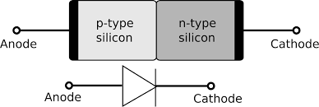
FORWARD AND REVERSE BIAS CHARACTERISTIC OF P-N JUNCTION DIODE

Slide 3
P-N junction
In n-type semiconductors, free electrons are the majority charge carriers whereas in p-type semiconductors, holes are the majority charge carriers. When the n-type semiconductor is joined with the p-type semiconductor, a p-n junction is formed. The p-n junction, which is formed when the p-type and n-type semiconductors are joined, is called as p-n junction diode.

Slide 4
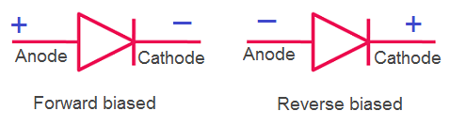
P-N junction semiconductor diode
A p-n junction diode is two-terminal or two-electrode semiconductor device, which allows the electric current in only one direction while blocks the electric current in opposite or reverse direction. If the diode is forward biased, it allows the electric current flow. On the other hand, if the diode is reverse biased, it blocks the electric current flow. P-N junction semiconductor diode is also called as p-n junction semiconductor device.

Slide 5
Biasing of p-n junction semiconductor diode
The process of applying the external voltage to a p-n junction semiconductor diode is called biasing. External voltage to the p-n junction diode is applied in any of the two methods: forward biasing or reverse biasing.
If the p-n junction diode is forward biased, it allows the electric current flow. Under forward biased condition, the p-type semiconductor is connected to the positive terminal of battery whereas; the n-type semiconductor is connected to the negative terminal of battery.
If the p-n junction diode is reverse biased, it blocks the electric current flow. Under reverse biased condition, the p-type semiconductor is connected to the negative terminal of battery whereas; the n-type semiconductor is connected to the positive terminal of battery.

Slide 6



NOW LET US GO TO THE EXPERIMENT

Slide 7
Aim
To study the functionality of PN junction diode Characteristics in forward bias and reverse bias condition.

Slide 8
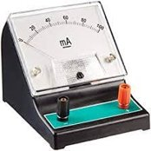
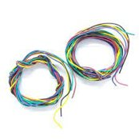
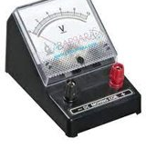
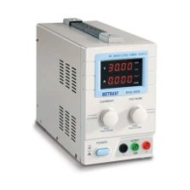
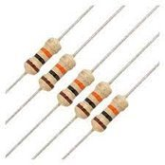
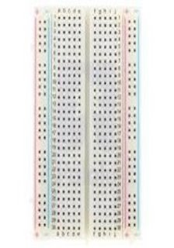
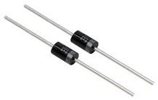
Apparatus required

Slide 9
Apparatus required
Sl.No. | Apparatus | Range | Quantity
1 | RPS | (0-30V) | 1
2 | Resistor | 1KΩ | 1
3 | Diode | 1N4007 | 1
4 | Ammeter | (0-200mA) and (0-2000µA) | Each 1
5 | Voltmeter | (0-20V) | 1
6 | Bread Board & wires | - | -

Slide 10
Theory
A PN junction diode is a two terminal device which supports unidirectional current flow and made of P-type and N-type materials.
For biasing PN junction diode applying external D.C. voltage. Depending upon the polarity of D.C. voltage externally applied to diode, the biasing is classified as forward biasing and Reverse biasing
Forward bias operation:
To forward bias the PN junction diode +ve terminal of supply to anode and –ve terminal of supply to cathode is connected. The diode starts conducting when the external voltage becomes more than the value of potential barrier (for Si=0.7V). Both holes and electrons cross the junction simultaneously and constitute forward current. Considering current flowing through the diode is large the diode can be approximated as short circuited switch.
Reverse bias operation:
To reverse bias the PN junction diode -ve terminal of supply to anode and +ve terminal of supply to cathode is connected. When voltage applied both holes and electrons move away from the junction creating a depletion layer and due to minority charge carriers there will be small current flowing called as reverse saturation current. Thus the current is negligible and the diode can be approximated as an open circuit.

Slide 11
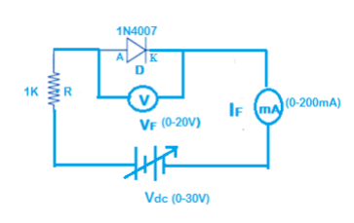
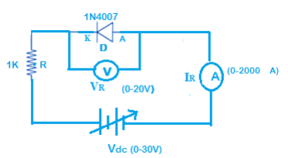
Circuit Diagram:
Forward Bias Condition:
Reverse Bias Condition:

Slide 12
Observation Table:
Forward Bias Condition:
Reverse Bias Condition:
Sl. No | RPS Voltage V_{dc} (Volts) | Forward Voltage across the diode V_{f} (volts) | Forward Current through the diode I_{f} (mA)
1
2
3
4
Sl. No | RPS Voltage V_{dc} (Volts) | Forward Voltage across the diode V _{f} (volts) | Reverse Current through the diode I _{r} (µA)
1
2
3
4

Slide 13
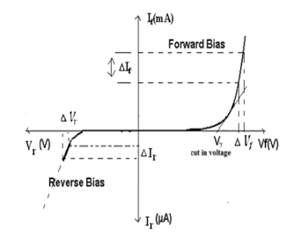
Model Graph:

Slide 14
Procedure:
1. Connect the circuit as shown in fig(1).
1
2. Initially vary Regulated Power Supply (RPS) voltage Vdc in steps of 0.1V. Note down the corresponding ammeter and Voltmeter reading.
2
3. Once Vf reaches 0.7V and current starts increasing vary the supply Vdc in steps of 4V, note down the corresponding reading and repeat for 2-3 steps.
3
4. Plot the graph V_{f} v/s I_{f} and calculate the dynamic resistance.
4
Forward bias condition:

Slide 15
Procedure:
1. Connect the circuit as shown in fig (2).
2. Vary Regulated Power Supply (RPS) voltage Vdc in steps of 1V or 2V and note down the corresponding ammeter and Voltmeter reading.
3. Repeat the same for 7 to 8 steps.
4. Plot the graph Vr v/s Ir.
Reverse bias condition: ​

Slide 16
Result:
V-I characteristics of PN junction diode is studied and plotted the graph for the same.
1. The Cut in Voltage or Knee Voltage (Vf) of 1N4007 is Volts.
2. The Dynamic Forward resistance of 1N4007 is Ω

Slide 17
Advantages of p-n junction diode
P-n junction diode is the simplest form of all the semiconductor devices. However, diodes plays a major role in many electronic devices.
A p-n junction diode can be used to convert the alternating current (AC) to the direct current (DC).
These diodes are used in power supply devices.
The p-n junction diode is used as electronic switch in digital logic circuits.

Slide 18


